Slide 1

職場故事​
(Animaze)​
Notes:
https://pixabay.com/videos/coding-programming-163491/

Slide 2
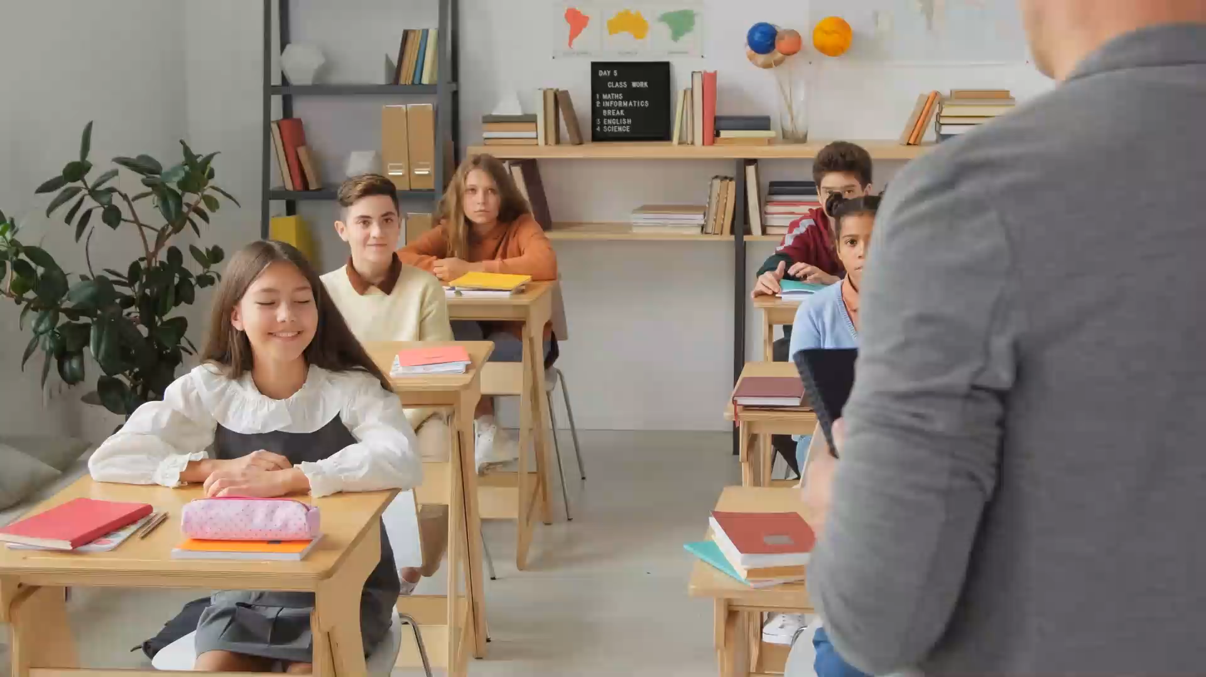
1. 目標
Notes:
https://pixabay.com/videos/students-class-classroom-education-215475/

Slide 3

1. 目標
Notes:
https://pixabay.com/videos/knight-3d-medieval-armor-man-31210/

Slide 4
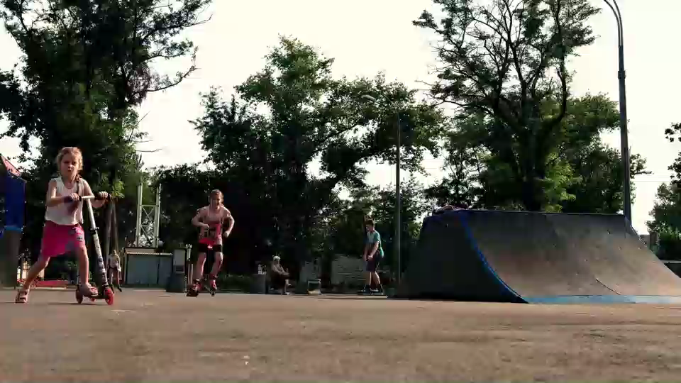
2. 阻礙
Notes:
https://pixabay.com/videos/park-children-playground-40822/

Slide 5
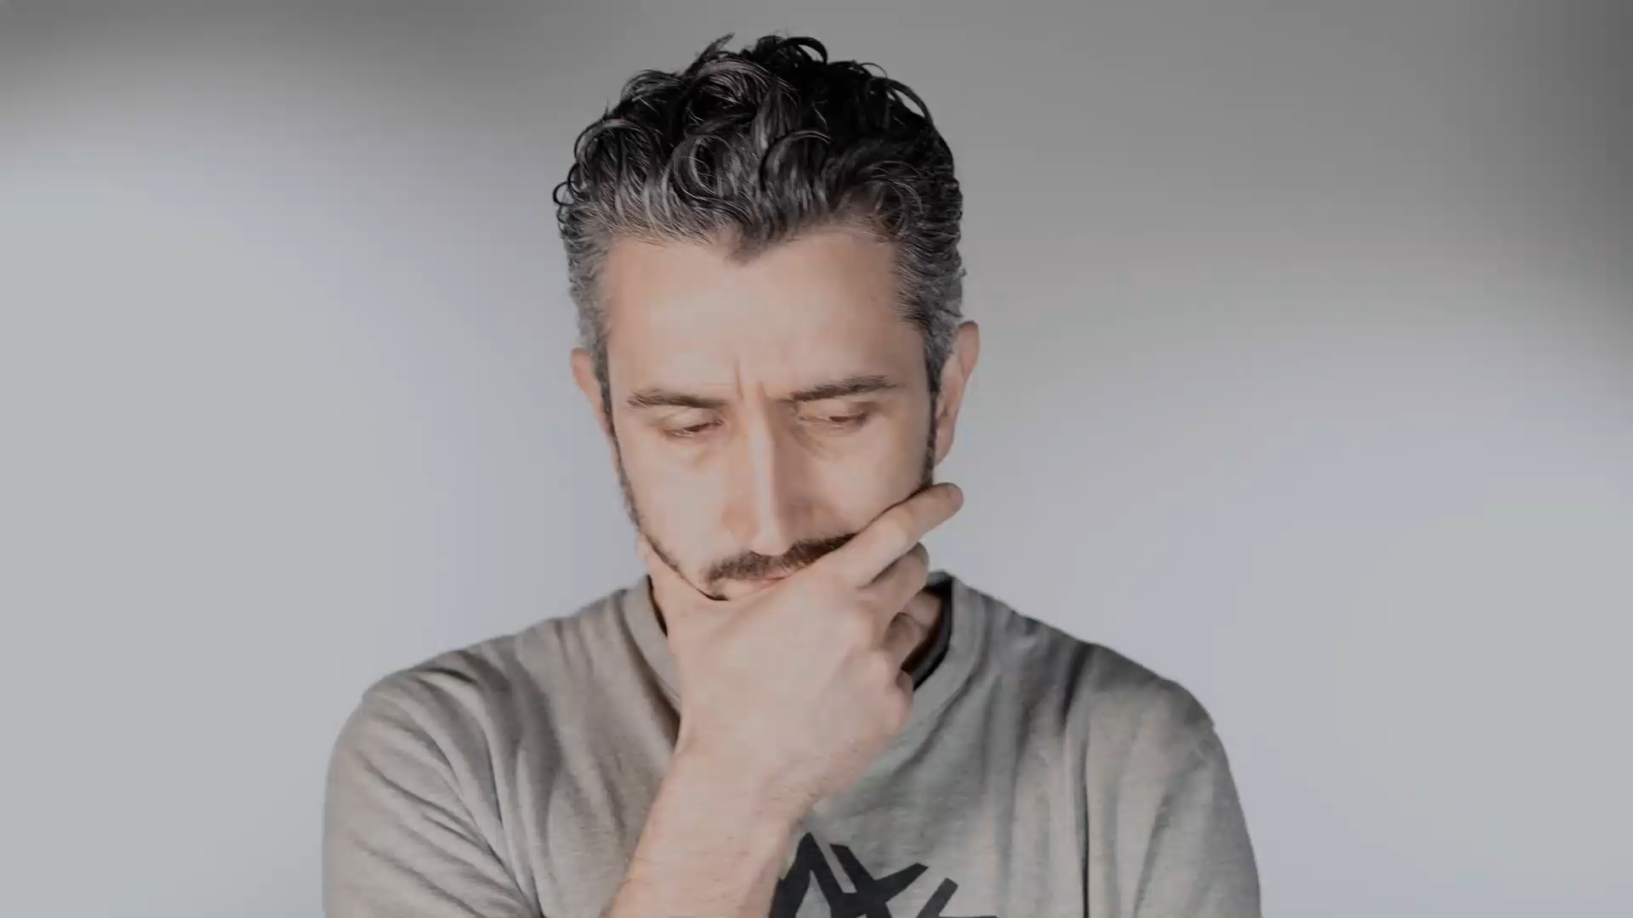
2. 阻礙
Notes:
https://pixabay.com/videos/man-think-beard-thoughtful-203251/

Slide 6
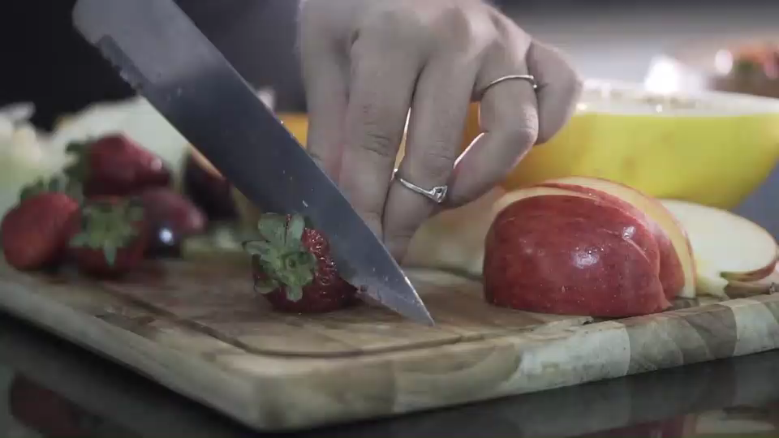
3. 努力
Notes:
https://pixabay.com/videos/fruit-cutting-food-cut-healthy-33249/

Slide 7
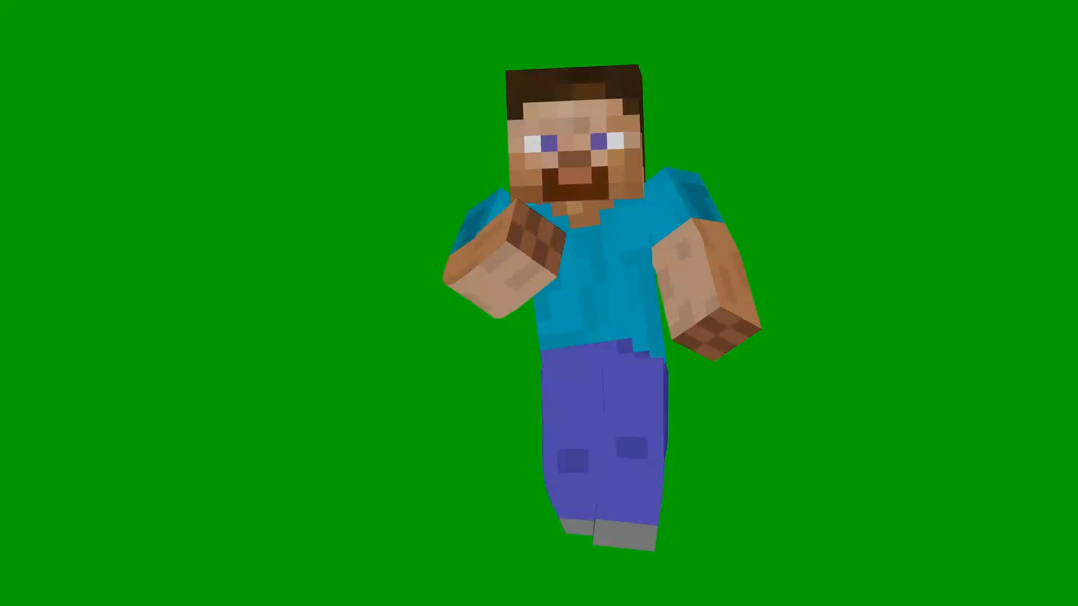
4. 結果
Notes:
https://pixabay.com/videos/dance-green-screen-mindcraft-steve-46012/

Slide 8
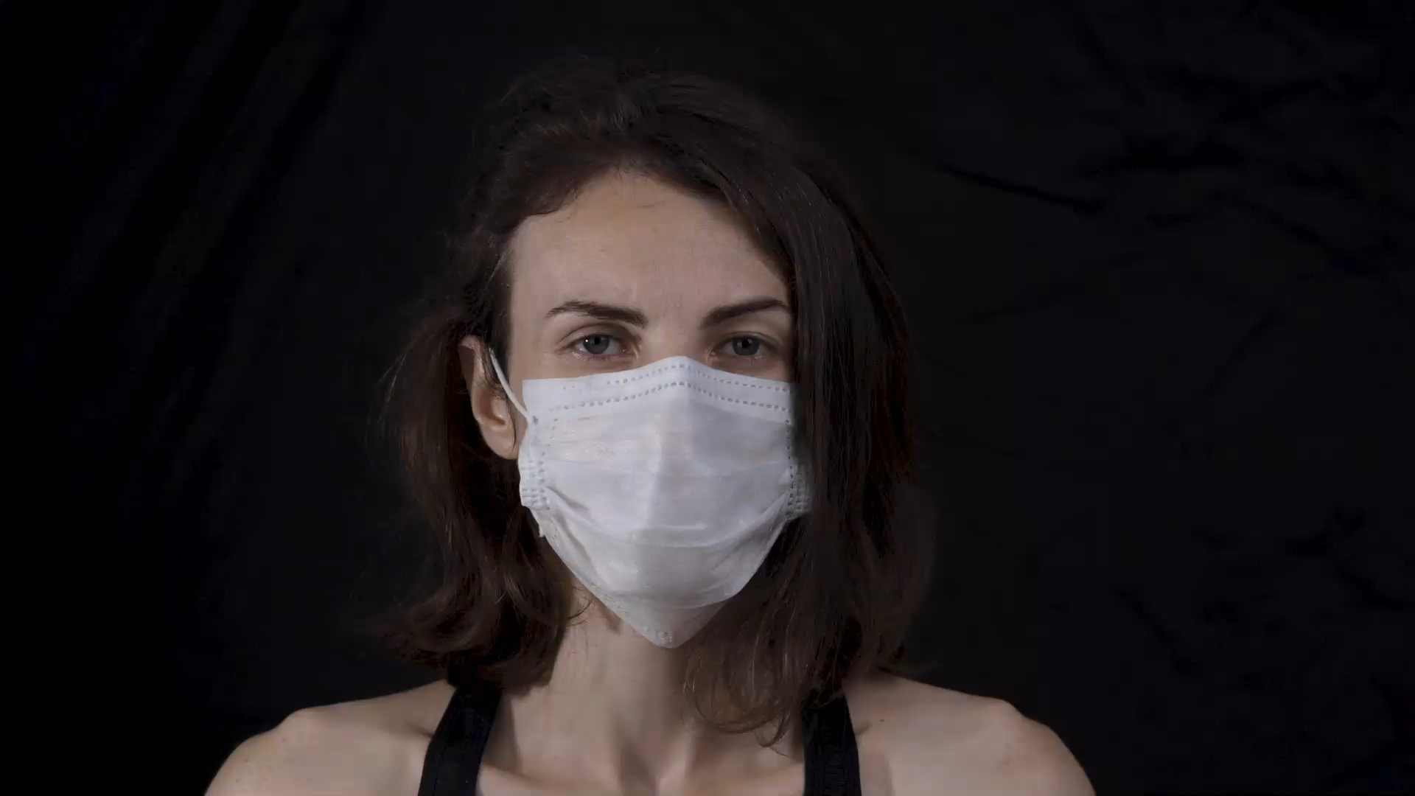
5. 意外
Notes:
https://pixabay.com/videos/woman-coronavirus-mask-quarantine-44641/

Slide 9
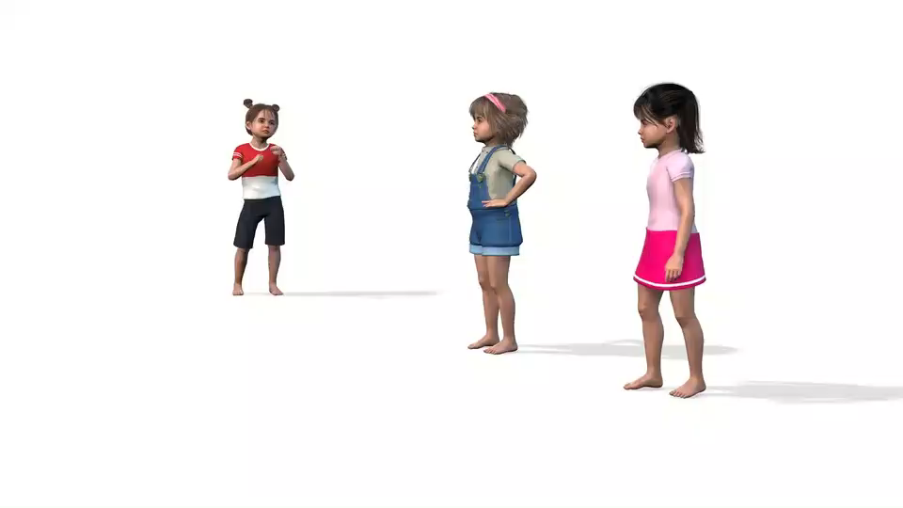
5. 意外
Notes:
https://pixabay.com/videos/kids-playing-fun-childhood-149939/

Slide 10
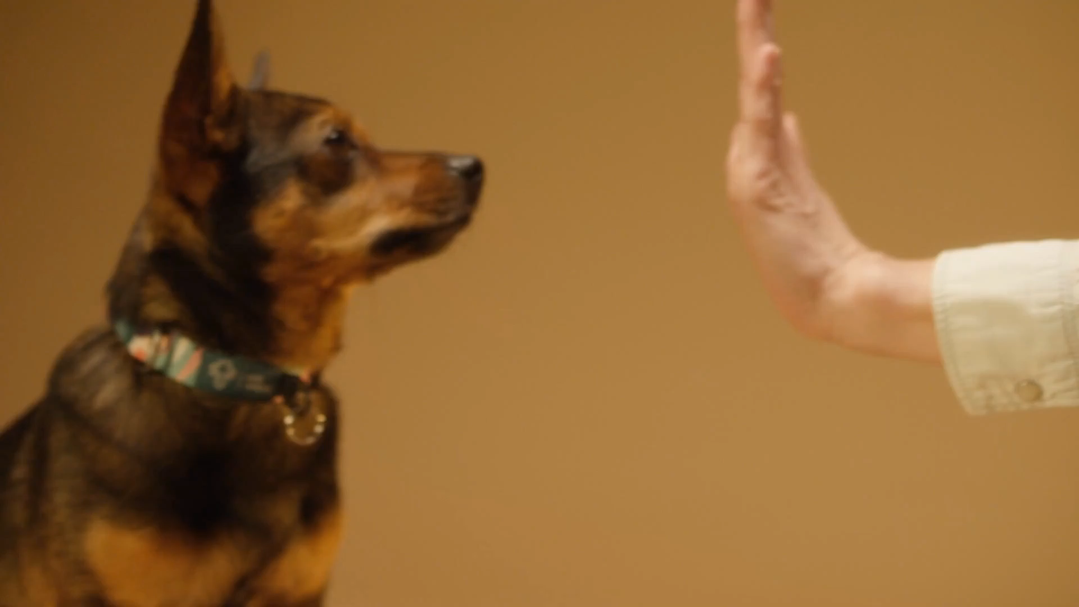
6. 轉彎
Notes:
https://pixabay.com/videos/dog-puppy-human-high-5-smart-135025/

Slide 11

6. 轉彎
Notes:
https://pixabay.com/videos/squares-cubes-motion-graphics-149701/

Slide 12
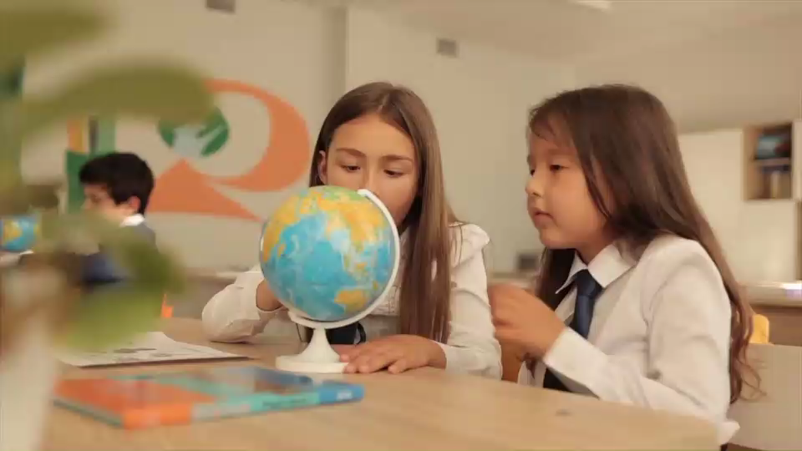
6. 轉彎
Notes:
https://pixabay.com/videos/students-girls-globe-erth-class-89066/

Slide 13
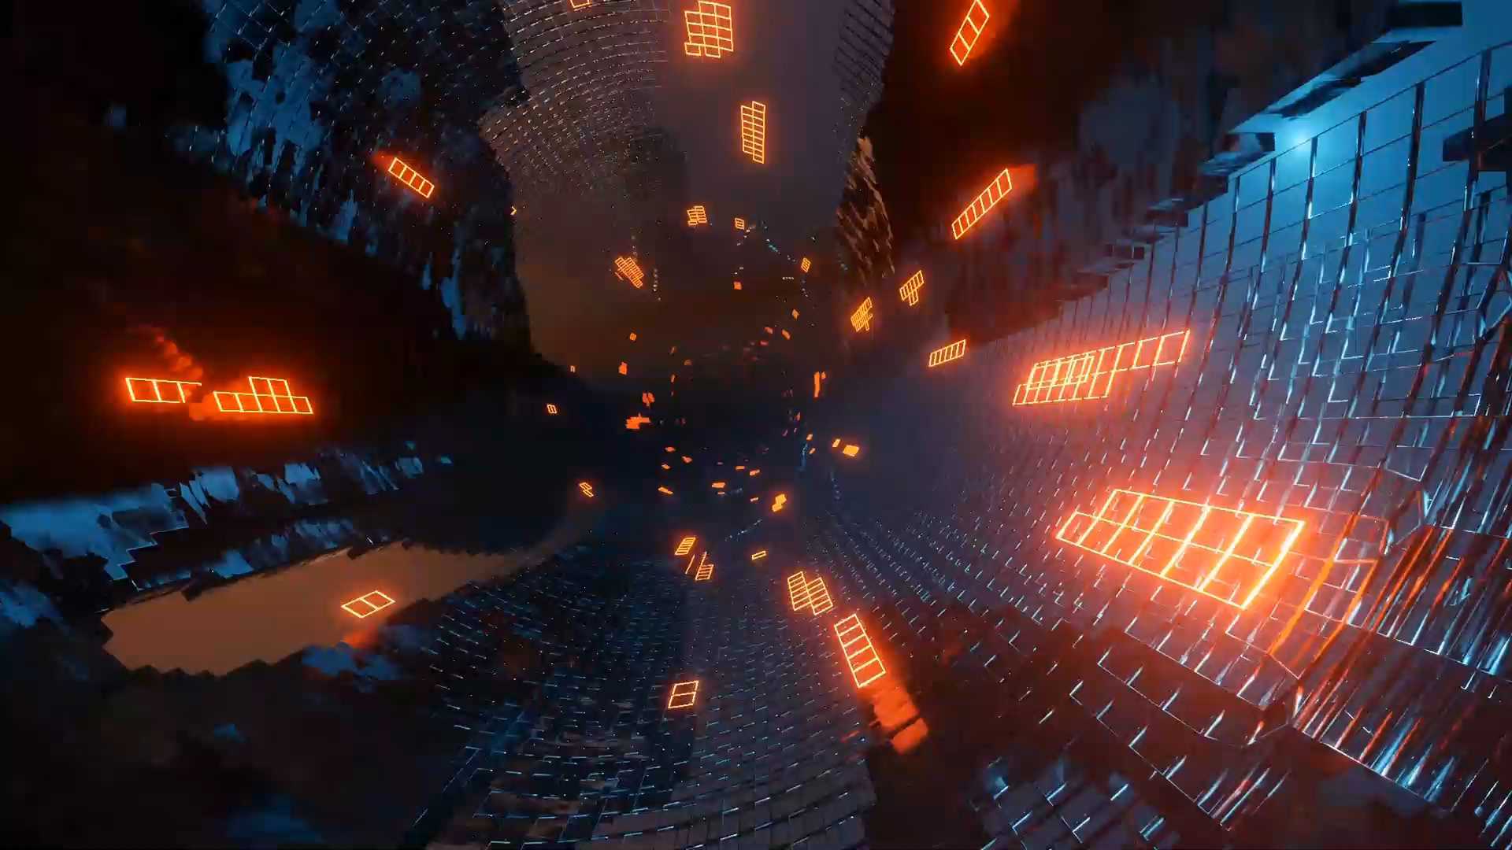
7. 結局
Notes:
https://pixabay.com/videos/tunnel-light-game-abstract-digital-179333/

Slide 14
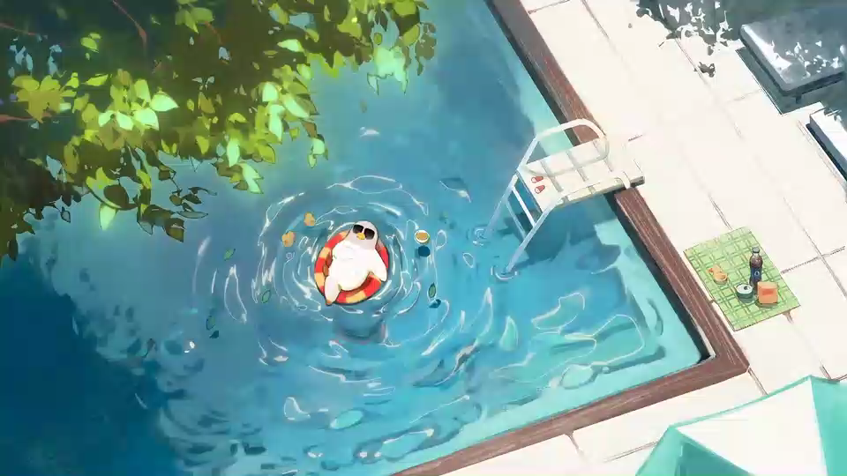
7. 結局
Notes:
https://pixabay.com/videos/pool-sunbathing-vacation-funny-95436/

